Slide 1

Server Automation: PowerShell vs. Shell Scripting
by (TEAM 6) Aadarsha K.C. , Suwan Dhital, Ronit Nepali,
Saima Bantawa, Bipin Guragain

Slide 2

What is PowerShell?
Task Automation & Configuration
Object-Oriented Commands
PowerShell is a Microsoft-developed framework designed for automating administrative tasks and managing configurations efficiently.
Built on the .NET framework, it uses cmdlets operating on objects, enabling complex data manipulation and easy automation.
Cross-Platform Availability
Initially native to Windows, PowerShell now runs on Linux and macOS through PowerShell Core, expanding its reach significantly.

Slide 3
What is Shell Scripting?
Command-Line Task Automation
Text-Based Processing
Shell scripting uses command-line interpreters like Bash or Zsh to automate routine tasks on Unix-like systems.
Unlike object-based PowerShell, shell scripts process data as strings, relying on tools like awk, sed, and grep.
Scripts manipulate plain text commands and utilities, making it simple yet powerful for managing Linux and macOS systems.
This text-centric approach makes shell scripts versatile for tasks that involve string parsing and file manipulations.

Slide 4
Syntax and Structure
PowerShell Syntax
Shell Scripting Syntax
Uses Verb-Noun cmdlets like Get-Process, supporting object pipelines for elegant data handling.
Commands are chained with pipes (|) and involve variables and control structures for flow control.
Example: Get-Process | Where-Object {$_.CPU -gt 1} | Sort-Object CPU -Descending
Example: ps aux | awk '{print $2, $3, $4, $11}' | sort -k3 -r

Slide 5

Cross-Platform Compatibility
PowerShell
Native to Windows, with PowerShell Core offering official cross-platform support on Linux and macOS.
Open-source and actively supported by Microsoft and the community.
Shell Scripting
Native on Linux and macOS, widely used for server automation in Unix environments.
On Windows, it requires environments like Cygwin or WSL, sometimes needing script adjustments for compatibility.

Slide 6


Object vs. Text-Based Processing
PowerShell Objects
Shell Scripting Text
Works directly with rich objects, allowing easy access and modification of properties without complex parsing.
Manipulates plain text output, requiring parsing and conversion to extract usable data.
1
2
Example: ps aux | grep notepad | awk '{print $3}' outputs text that may need further transformation.
Example: (Get-Process -Name notepad).CPU returns a numeric CPU usage value.

Slide 7
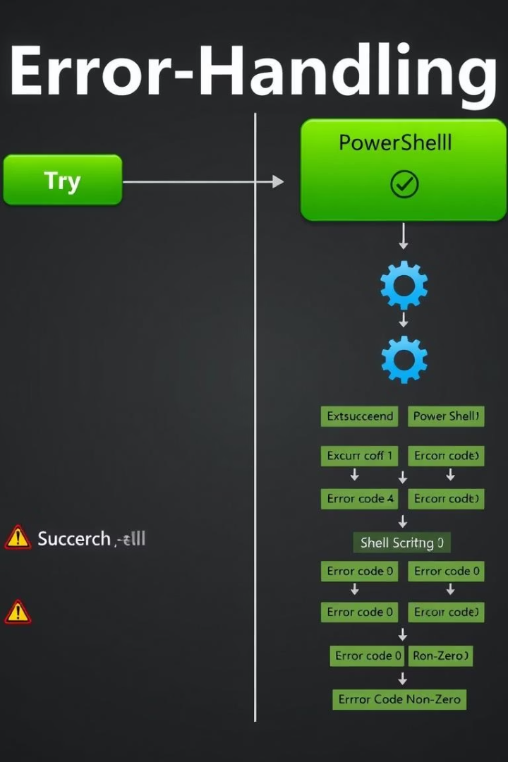


Error Handling and Reporting
PowerShell
Offers advanced error handling with try-catch blocks and detailed error objects for precise debugging.
Example: $ErrorActionPreference = "Stop"; try { ... } catch { Write-Host $_.Exception.Message }
Shell Scripting
Uses exit codes and conditional statements for error checking, simpler but less descriptive.
Example: command || { echo "Error!"; exit 1; }

Slide 8
Use Cases and Examples
PowerShell Use Cases
Shell Scripting Use Cases
Windows Server role configuration
Linux system administration
Active Directory management
Automated server deployments
Exchange server automation
Log file parsing and analysis
Patch deployment across large server farms
Orchestrating Docker containers

Slide 9



Advantages and Disadvantages
PowerShell Strengths
Shell Scripting Strengths
Powerful object manipulation and integration with Microsoft products make it ideal for complex automation.
Quick to write and ideal for straightforward tasks on Unix-like systems.
Less structured, which can complicate large, complex scripts.
However, it has a steeper learning curve for new users.

Slide 10

Conclusion: Choosing the Right Tool
Evaluate Environment and Task Complexity
Consider Cross-Platform Needs
Assess target platforms and automation needs before deciding your scripting approach.
PowerShell Core offers great cross-platform support; shell scripting shines in native Unix environments.
Embrace Hybrid Skills
Developing proficiency in both tools maximizes flexibility and effectiveness in diverse IT infrastructures.

Slide 11


